Slide 1



Introduction to Reinforcement Learning
Philip (Sterling) Osborne, PhD Student in AI Systems Lab Group
Philip.Osborne@postgrad.Manchester.ac.uk
https://www.linkedin.com/in/philip-osborne-1052a183
University of Manchester - Computer Science
Supervisor: Dr Andre Freitas
23/03/2022

Slide 2
Overview
A computational approach to learning from interaction
Reinforcement Learning aims to find optimal actions towards a long-term goal
Not supervised or unsupervised
Introduced by Sutton and Barto in Introduction to Reinforcement Learning book (1st ed. 1998 – 2nd ed. 2018)

Slide 3
Difference from Supervised Learning
An Supervised Learning approach is trained on set of labelled examples from a knowledgeable external supervisor
The label is the correct action for the given situation
The aim is to recognise the generalisable patterns that lead to the output labels

Slide 4
Difference from Unsupervised Learning
An Unsupervised Learning approach is about finding the structure hidden in collections of unlabelled data
RL is about maximising a reward signal, not trying to find a hidden structure

Slide 5
Core RL Definitions

Slide 6
Core Elements of RL
A reward signal is set by a controller
The learner must discover which actions yield the most reward by trial-and-error
Immediate actions made will often affect the long-term outcomes
Core RL Definitions

Slide 7
Core Elements of RL
The learner and decision maker is called an Agent
Everything else the agent interacts with is called the Environment
The environment is modelled as a Markov Decision Process (is defined formally later)
Core RL Definitions

Slide 8
Core Elements of RL
A Policy decides the agent’s actions at any given time
A Reward Signal sets the goal of the agent, is received by the agent after every action and can be positive or negative
A Value Function is learnt to specify the quality of states towards the goal (i.e. V(s) or Q(s,a))
Core RL Definitions

Slide 9
Exploration vs Exploitation
A primary challenge of RL is the trade-off between trying new actions against using ones that are already taken
The agent must try new action whilst favouring those that appear best
Ideally, each action must be tried as many times as required to gain a reliable estimate of its expected reward
See The Multi-Armed Bandit Problem for more info
Core RL Definitions

Slide 10
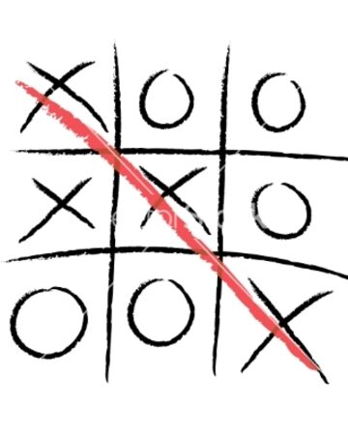
An Example Problem: Tic-Tac-Toe
Two players take turns with either an “X” or “O”
First to get three in a line wins
Cannot be solved with pure Mathematics because opponent’s decisions are not known
Want to estimate outcomes from experience by playing games
https://board-games-galore.fandom.com/wiki/Tic-tac-toe
Core RL Definitions

Slide 11
An Example Problem: Tic-Tac-Toe
To solve with a value function:
Setup a table with all possible states of the game
Initialise the value of each state towards winning as 0
Update values after each game
Repeat until convergence and apply results to win
https://board-games-galore.fandom.com/wiki/Tic-tac-toe
Core RL Definitions

Slide 12
Learning Principles

Slide 13
Action Selection
State A has a higher value than state B so is considered ‘better’ towards winning the game
A greedy selection picks the best action but wont explore
A random selection picks a random action but wont exploit
Epsilon-greedy action selection will randomly selection an action with probability = epsilon and greedily otherwise (i.e. 1-epsilon)
Learning Principles

Slide 14
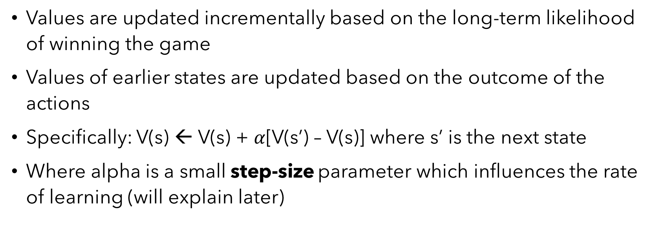
Updating Values
Values are updated incrementally based on the long-term likelihood of winning the game
Values of earlier states are updated based on the outcome of the actions
Specifically: V(s) ← V(s) + $α$[V(s’) – V(s)] where s’ is the next state
Where alpha is a small step-size parameter which influences the rate of learning (will explain later)
Learning Principles

Slide 15
Updating Values
V(s) ← V(s) + $α$[V(s’) – V(s)] → e.g. $α$ = 0.25 → agent plays ‘X’
State A (Greedy Choice)
V(s) = 0.2 + 0.25(+1-0.2)
=> V(s) = 0.2 + 0.2 = 0.4
State B (Random Choice)
V(s) = 0.2 + 0.25(-0.6-0.2)
=> V(s) = 0.2 - 0.1 = 0.1
Learning Principles

Slide 16
Model-Based vs Model-Free Methods
Model-based methods use the knowledge of the probabilistic environment as a guide and plans the best actions accordingly
In model-free methods, the algorithm has no knowledge of the probabilities
E.g. if we knew the tic-tac-toe opponent’s underlying decision making then it is model-based, but we do not so learn based on outcomes then it is model-free
Learning Principles

Slide 17
Environment Model

Slide 18
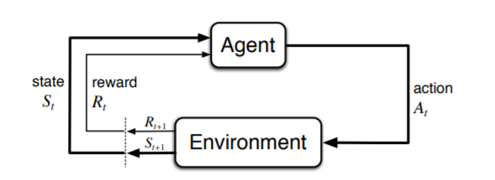
Markov Decision Processes (MDPs)
MDPs are a formalization for sequential decision making:
Aim is to compute the value of state, V(s), or the value of state-action pairs, Q(s,a).
The agent and environment interact continuously
The agent-environment interaction in an MDP
Environment Model

Slide 19
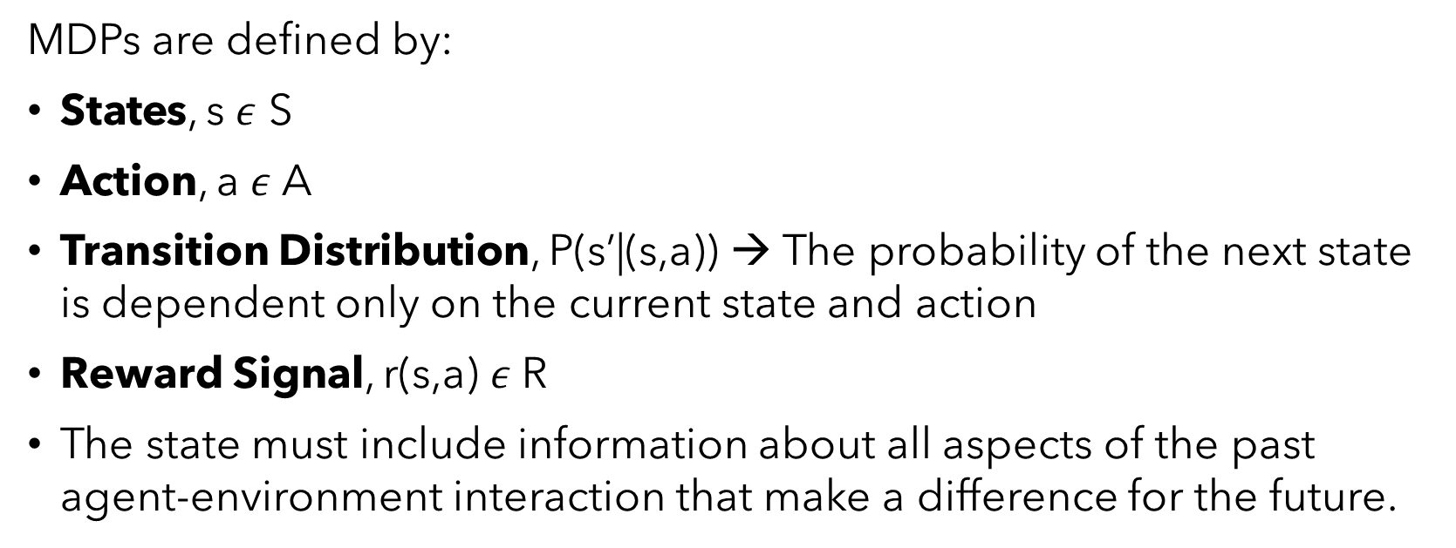
Markov Decision Processes (MDPs)
MDPs are defined by:
States, s $ε$ S
Action, a $ε$A
Transition Distribution, P(s’|(s,a)) → The probability of the next state is dependent only on the current state and action
Reward Signal, r(s,a) $ε$R
The state must include information about all aspects of the past agent-environment interaction that make a difference for the future.
Environment Model

Slide 20
Markov Decision Processes (MDPs)
The MDP and Agent give rise to a sequence:
s_{0,} a₀, r₁, s₁, a₁, r₁,…
The Agent is driven to a goal by the reward signal by maximising the cumulative reward over all action in the sequence
s
a
s
a
s
a
s
Environment Model

Slide 21
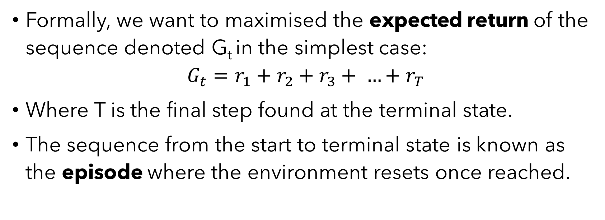
Returns and Episodes
Formally, we want to maximised the expected return of the sequence denoted G_{t} in the simplest case:
$$G_{t}=r_{1}+r_{2}+r_{3}+ …+r_{T}$$
Where T is the final step found at the terminal state.
The sequence from the start to terminal state is known as the episode where the environment resets once reached.
Environment Model

Slide 22
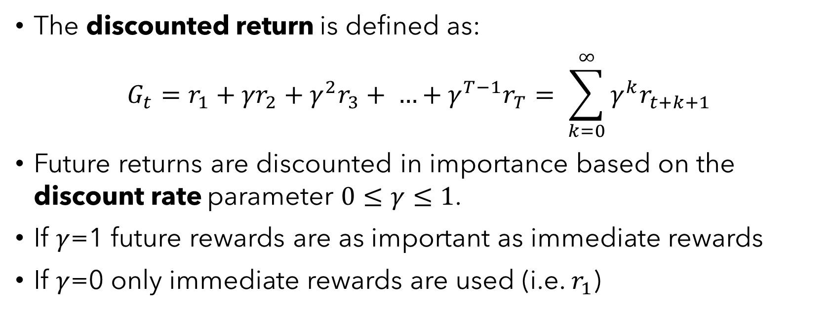
Discounted Return
The discounted return is defined as:
$$G_{t}=r_{1}+{γr}_{2}+{γ^{2}r}_{3}+ …+{γ^{T−1}r}_{T}= \sum_{k=0}^{∞}{γ^{k}r_{t+k+1}}$$
Future returns are discounted in importance based on the discount rate parameter $0≤γ≤1$.
If $γ$=1 future rewards are as important as immediate rewards
If $γ$=0 only immediate rewards are used (i.e. $r_{1}$)
Environment Model

Slide 23
Model-Based Learning

Slide 24
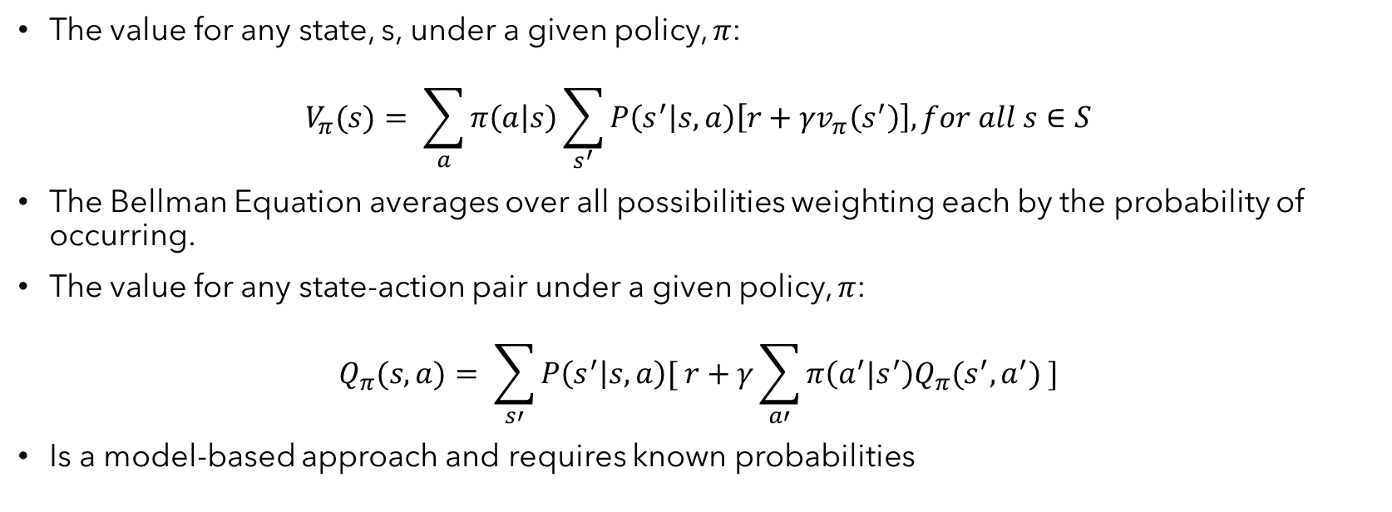
Bellman Equation
The value for any state, s, under a given policy, $π$:
$$V_{π}(s)= \sum_{a}{π\left(a | s\right)\sum_{s^{′}}{P\left(s^{′} | s,a\right)\left[r+γv_{π}\left(s^{′}\right)\right], for all s∈S}}$$
The Bellman Equation averages over all possibilities weighting each by the probability of occurring.
The value for any state-action pair under a given policy, $π$:
$$Q_{π}(s,a)= \sum_{s′}{P\left(s^{′} | s,a\right)[ r+γ\sum_{a′}{π\left(a^{′}|s^{′}\right)Q_{π}(s^{′},a^{′}) ]}}$$
Is a model-based approach and requires known probabilities
Model-Based Learning

Slide 25
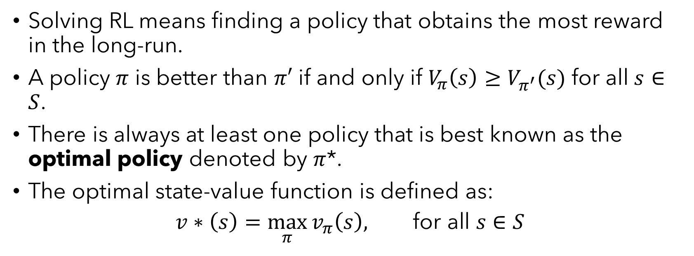
Optimal Policies and Value Functions
Solving RL means finding a policy that obtains the most reward in the long-run.
A policy $π$ is better than $π′$ if and only if $V_{π}\left(s\right)≥V_{π^{′}}(s)$ for all $s∈S$.
There is always at least one policy that is best known as the optimal policy denoted by $π$*.
The optimal state-value function is defined as:
$$v∗\left(s\right)=\max_{π}{v_{π}\left(s\right), \text{for} \text{all} s∈S}$$
Model-Based Learning

Slide 26
Dynamic Programming (DP)
A collection of algorithms to find the optimal policy given a perfect model of the environment as an MDP.
Assume MDP is finite with discrete state and actions.
DP algorithms use the value functions to organise and structure the search for good policies.
Model-Based Learning

Slide 27
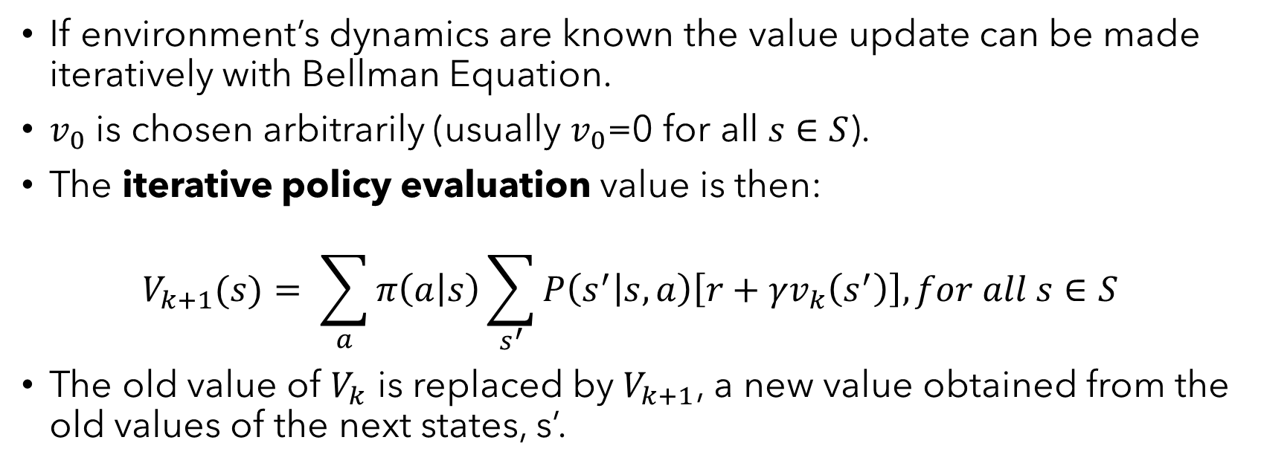
Policy Evaluation
If environment’s dynamics are known the value update can be made iteratively with Bellman Equation.
$v_{0}$ is chosen arbitrarily (usually $v_{0}$=0 $\text{for} \text{all} s∈S$).
The iterative policy evaluation value is then:
$$V_{k+1}(s)= \sum_{a}{π\left(a | s\right)\sum_{s^{′}}{P\left(s^{′} | s,a\right)\left[r+γv_{k}\left(s^{′}\right)\right], for all s∈S}}$$
The old value of $V_{k}$ is replaced by $V_{k+1}$, a new value obtained from the old values of the next states, s’.
Model-Based Learning

Slide 28
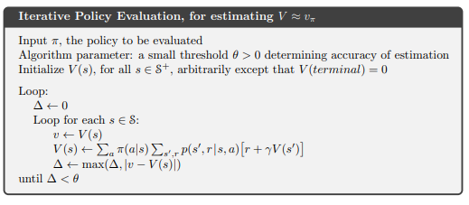
Policy Evaluation
Updates are made in a sweep through the state space
An in-place version of iterative policy evaluation is defined by:
Model-Based Learning

Slide 29
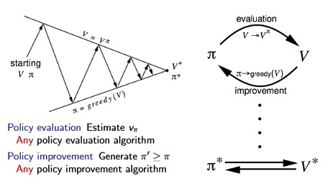
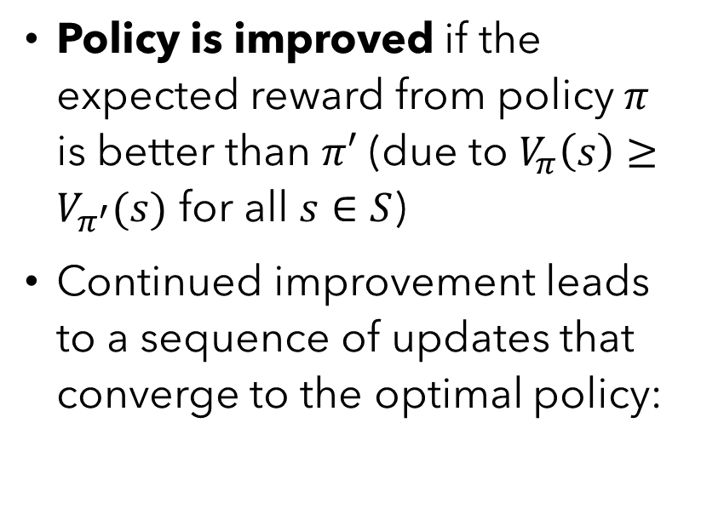
Policy Improvement and Iteration
Policy is improved if the expected reward from policy $π$ is better than $π′$ (due to $V_{π}\left(s\right)≥V_{π^{′}}(s)$ for all $s∈S$)
Continued improvement leads to a sequence of updates that converge to the optimal policy:
https://github.com/omerbsezer/Reinforcement_learning_tutorial_with_demo
Model-Based Learning

Slide 30
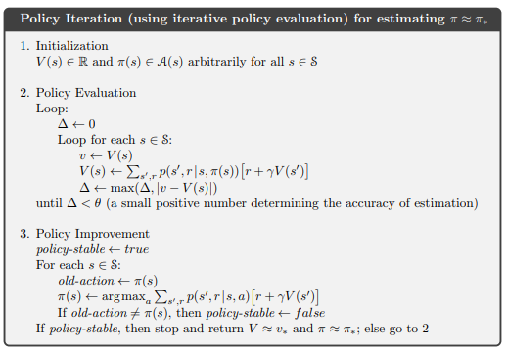
Policy Improvement and Iteration
The complete policy iteration algorithm is defined by:
Model-Based Learning

Slide 31
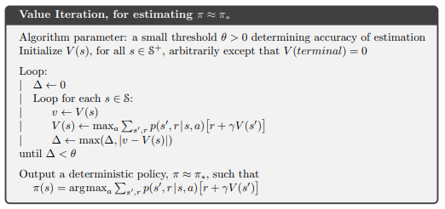
Value Iteration
One drawback to policy iteration involved policy evaluation until convergence
Instead, the evaluation can be made after a single sweep by value iteration
Model-Based Learning

Slide 32
Model-Free Learning

Slide 33
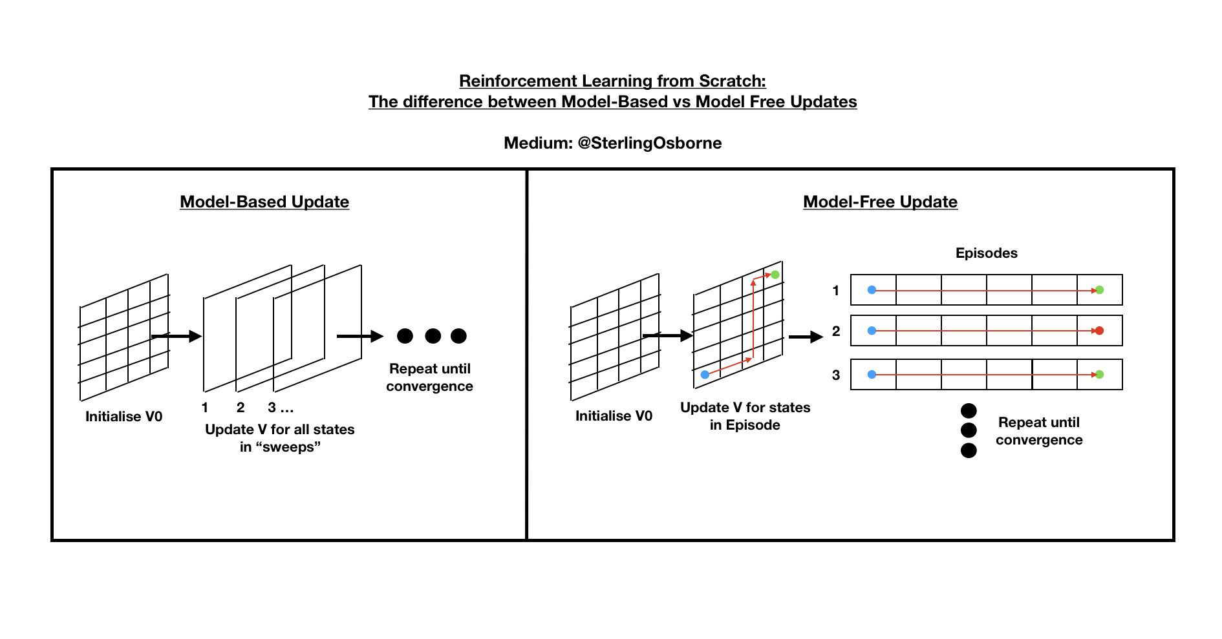
Model-Free Updates
Model-Free Learning

Slide 34
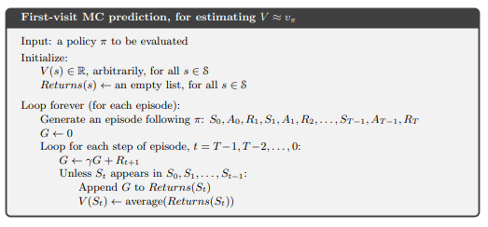
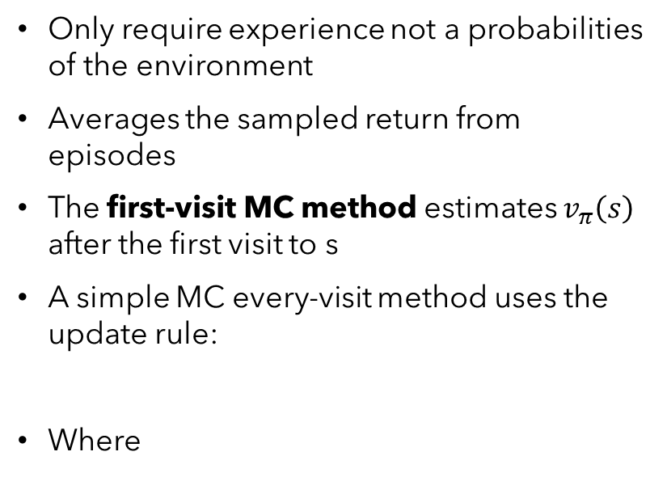
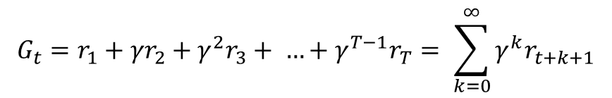

Monte-Carlo Learning
Only require experience not a probabilities of the environment
Averages the sampled return from episodes
The first-visit MC method estimates $v_{π}\left(s\right)$ after the first visit to s
A simple MC every-visit method uses the update rule:
Where
$$V\left(S\right)←V\left(S\right)+ α[G_{t}−V\left(S\right)]$$
$$G_{t}=r_{1}+{γr}_{2}+{γ^{2}r}_{3}+ …+{γ^{T−1}r}_{T}= \sum_{k=0}^{∞}{γ^{k}r_{t+k+1}}$$
Model-Free Learning

Slide 35
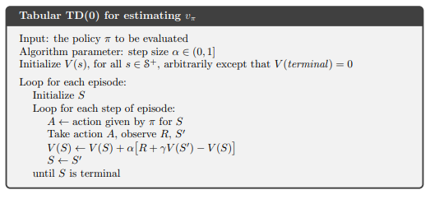
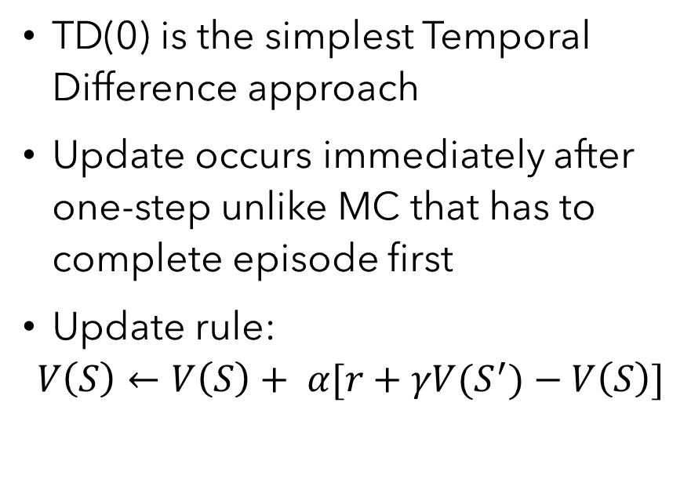
Temporal-Difference 0 – TD(0)
TD(0) is the simplest Temporal Difference approach
Update occurs immediately after one-step unlike MC that has to complete episode first
Update rule:
$$V\left(S\right)←V\left(S\right)+ α[r+γV(S^{′})−V\left(S\right)]$$
Model-Free Learning

Slide 36
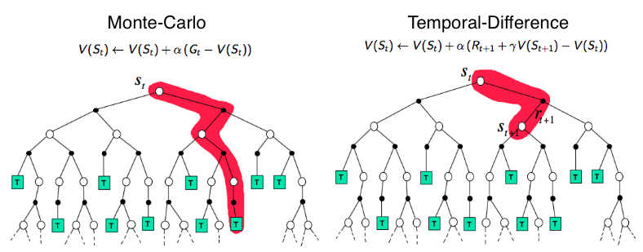
MC vs TD(0) Backup Diagram
https://lilianweng.github.io/lil-log/2018/02/19/a-long-peek-into-reinforcement-learning.html
Model-Free Learning

Slide 37
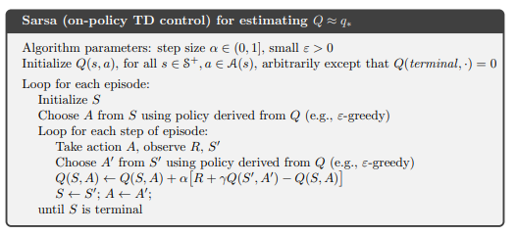
SARSA: On-policy TD Control
Consider transitions from state-action pair to state-action pair
Computes value of state-action pairs Q(S,A) after reaching every non-terminal state
If S’ is terminal, Q(S’,A’)=0
Update rule:
$$Q\left(S,A\right)←Q\left(S,A\right)+ α[r+γQ(S^{′},A′)−Q\left(S,A\right)]$$
Model-Free Learning

Slide 38
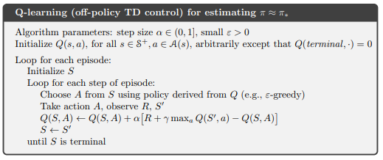
Q-Learning: Off-policy TD Control
Approximates the optimal action-value policy independent of the policy being followed
Simplifies the analysis and convergence can be proved
Update rule:
$$Q\left(S,A\right)←Q\left(S,A\right)+ α[r+γ\max_{a}{Q(S^{′},a)}−Q\left(S,A\right)]$$
Model-Free Learning

Slide 39
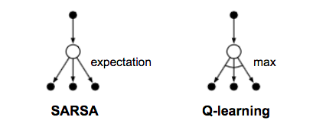
SARSA vs Q-Learning Backup Diagram
$$Q\left(S,A\right)←Q\left(S,A\right)+ α[r+γQ(S^{′},A′)−Q\left(S,A\right)]$$
$$Q\left(S,A\right)←Q\left(S,A\right)+ α[r+γ\max_{a}{Q(S^{′},a)}−Q\left(S,A\right)]$$
https://lilianweng.github.io/lil-log/2018/02/19/a-long-peek-into-reinforcement-learning.html
Model-Free Learning

Slide 40
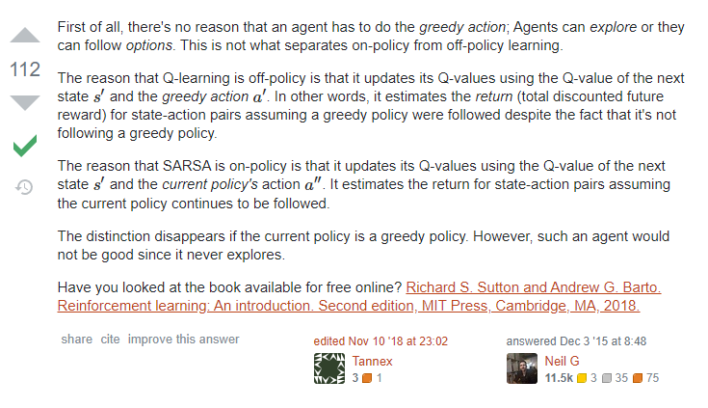
Off-Policy vs On-Policy
On-Policy evaluate or improve the policy that is used to make decisions
Off-Policy methods evaluate or improve a policy different from that used to generate the data
https://stats.stackexchange.com/questions/184657/what-is-the-difference-between-off-policy-and-on-policy-learning
Model-Free Learning

Slide 41
A Simple Example

Slide 42
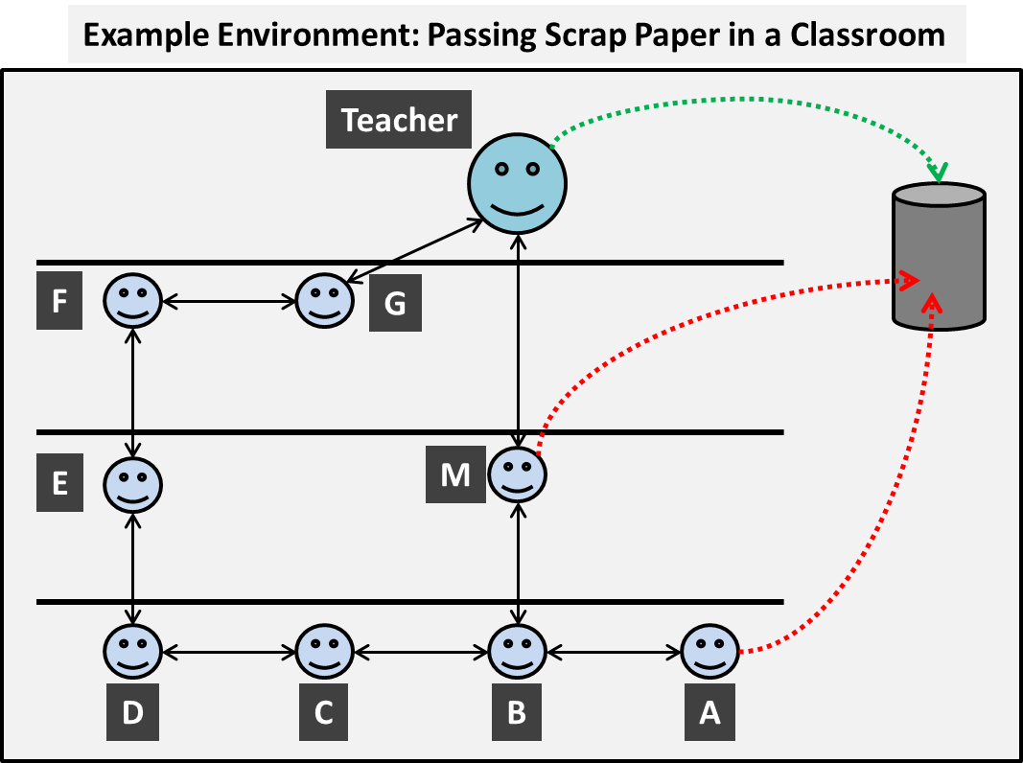
The Classroom Environment
The MDP for the environment is deﬁned by:
States are the students, teacher and the bin with 2-d(x,y) positions in the classroom
Actions are commands given to each state and are deﬁned by [up, down, left, right]
The transition probability function is deﬁned by the probability each state object has for successfully following the given action.
The reward function is simply deﬁned as +1 for reaching the positive goal, -1 for reaching the negative goal and a small negative reward (e.g. -0.04) otherwise to encourage decisions that lead to the positive goal
A Simple Example

Slide 43
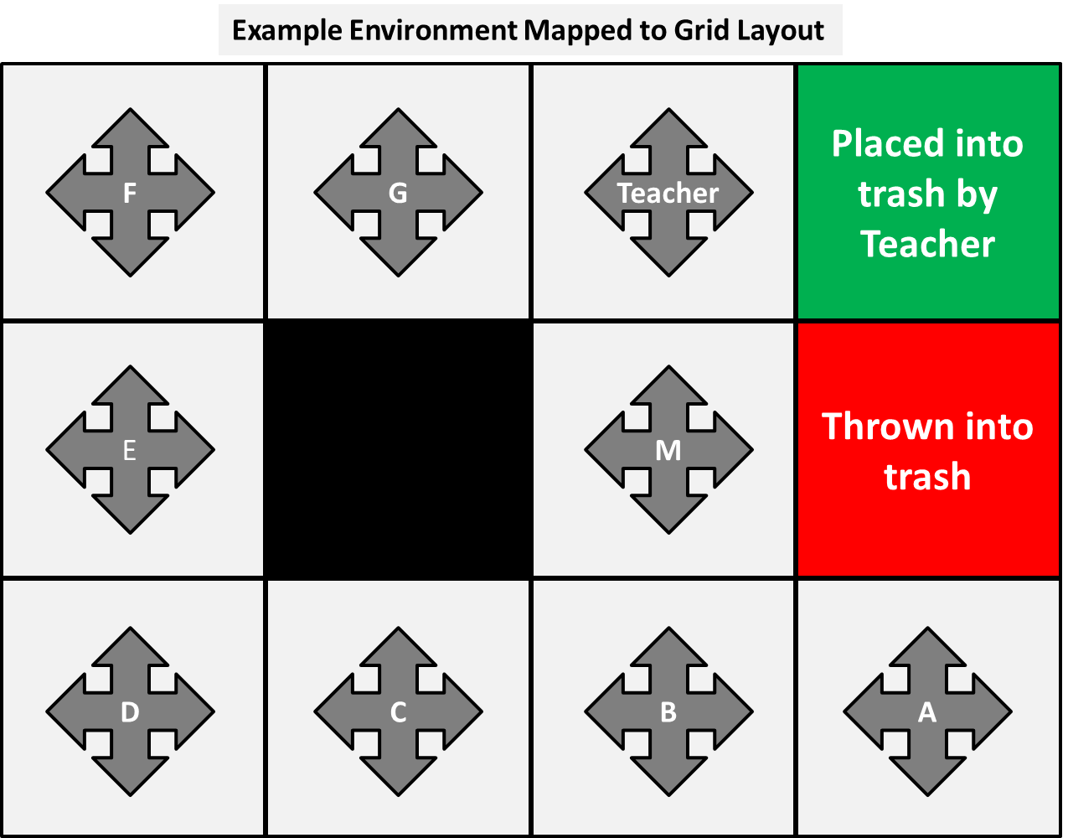
The Classroom Environment
The probabilities are defined by:
The next state will depend on the current [x,y] state, action and probability distribution. If a “wall” is hit (e.g. C := [2,1] and action “up”) then the next state will remain the same as the current state.
The teacher will always follow their command.
Other students have the probability of following the action set to 0.8 and 0.1 for every other action
The episode ends when the paper reaches the bin.
A Simple Example

Slide 44
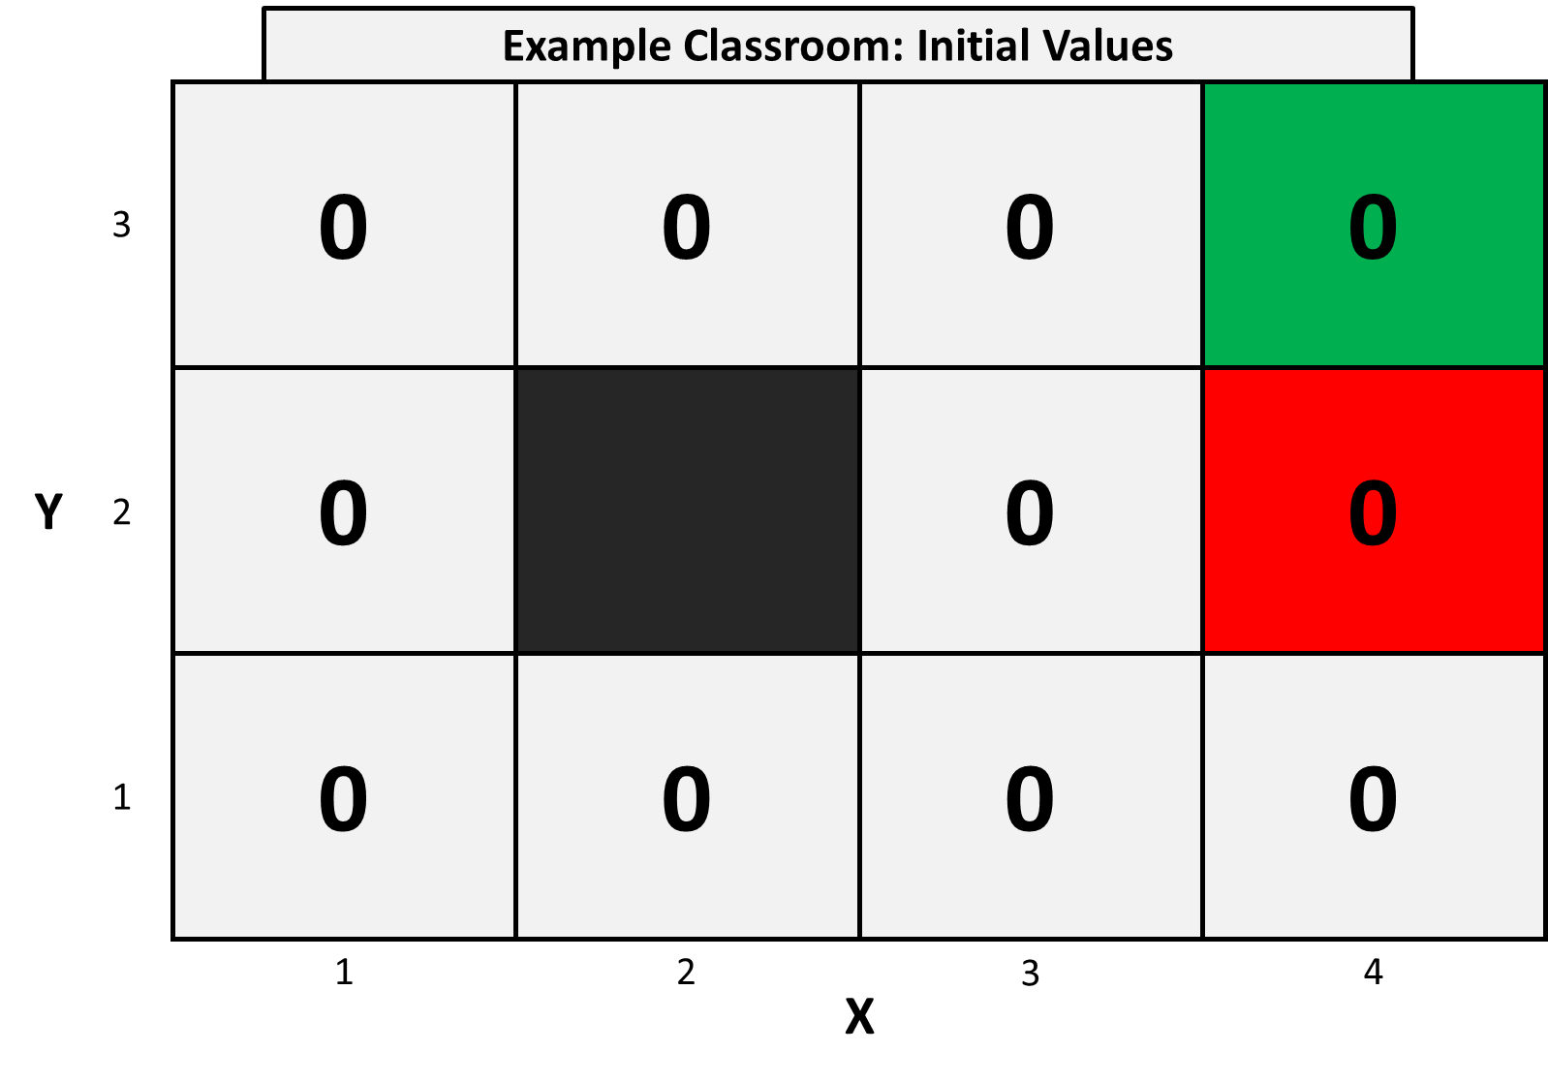
Initial Values
We initialise the value of all states, V(s), to 0
Likewise for all state-action values, Q(s,a)
A Simple Example

Slide 45
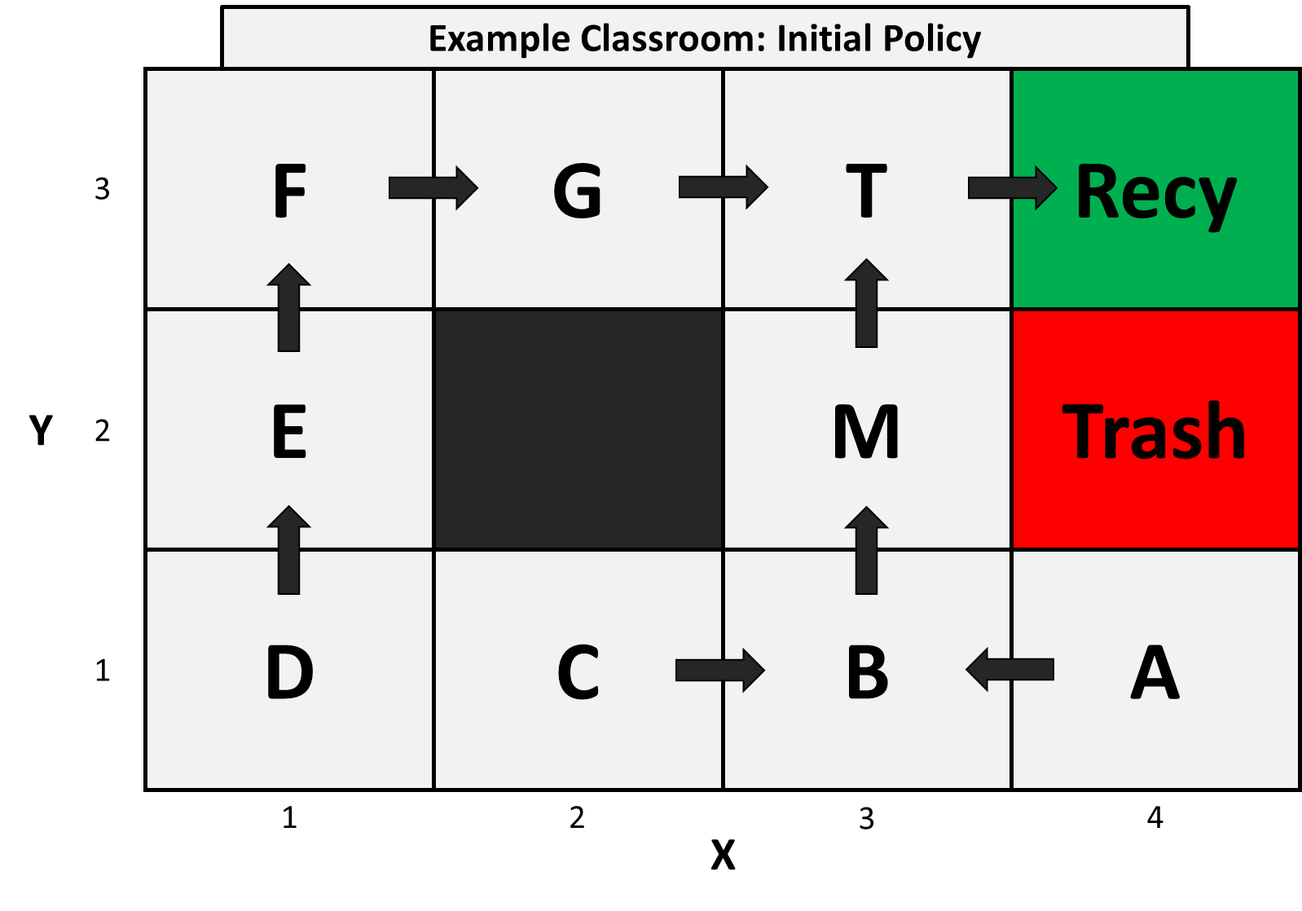
Initial Policy
We randomly set the initial policy to:
A Simple Example

Slide 46
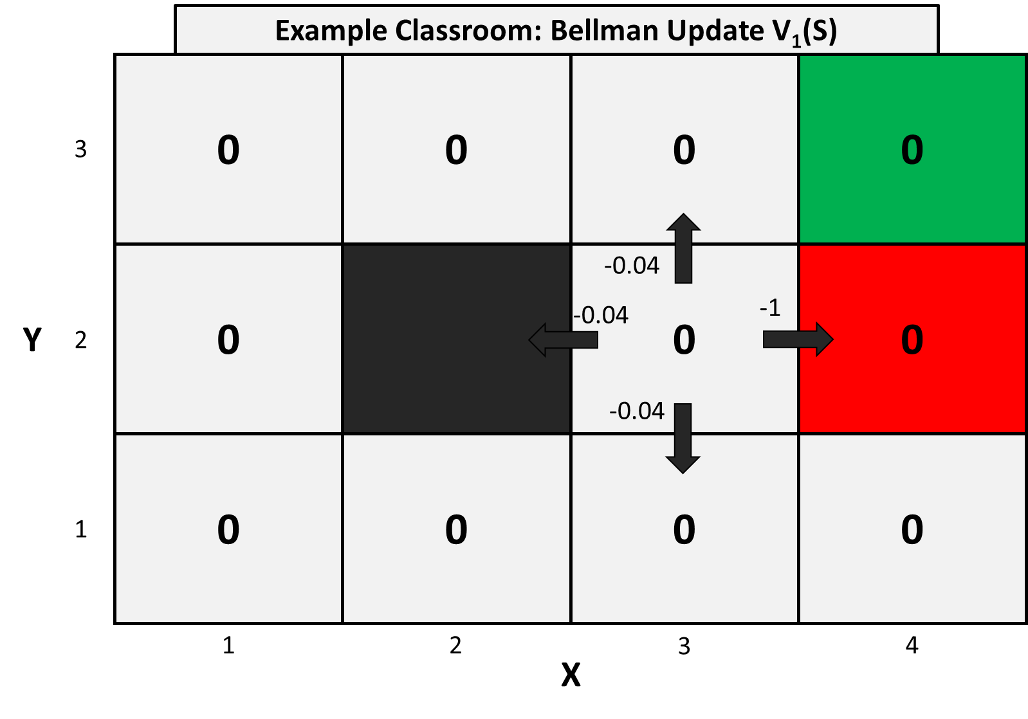

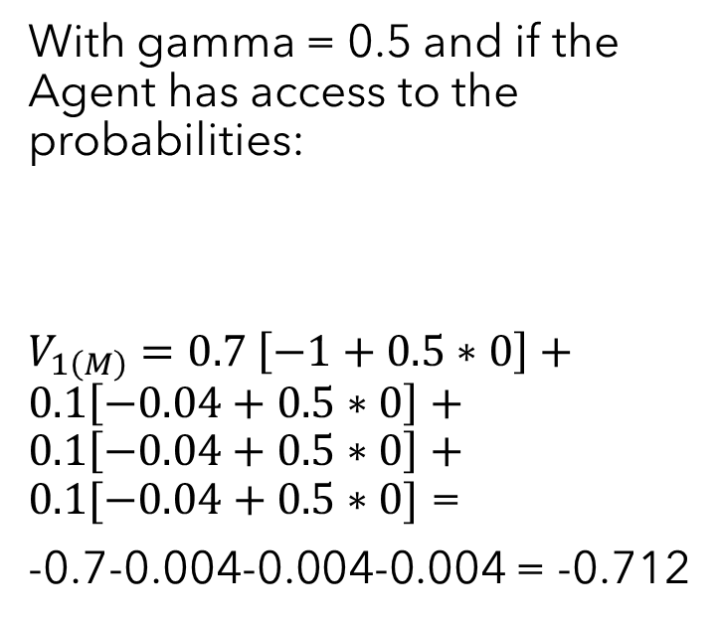
Model-Based Update
With gamma = 0.5 and if the Agent has access to the probabilities:
$V_{1\left(M\right)}=0.7 \left[−1+0.5∗0\right]+0.1\left[−0.04+0.5∗0\right]+0.1\left[−0.04+0.5∗0\right]+0.1[−0.04+0.5∗0]$ =
-0.7-0.004-0.004-0.004 = -0.712
$$V_{k+1}(s)= \sum_{a}{π\left(a | s\right)\sum_{s^{′}}{P\left(s^{′} | s,a\right)\left[r+γv_{k}\left(s^{′}\right)\right], for all s∈S}}$$
r = +1 for positive goal,
r = -1 for negative goal,
r = -0.04 otherwise
A Simple Example

Slide 47
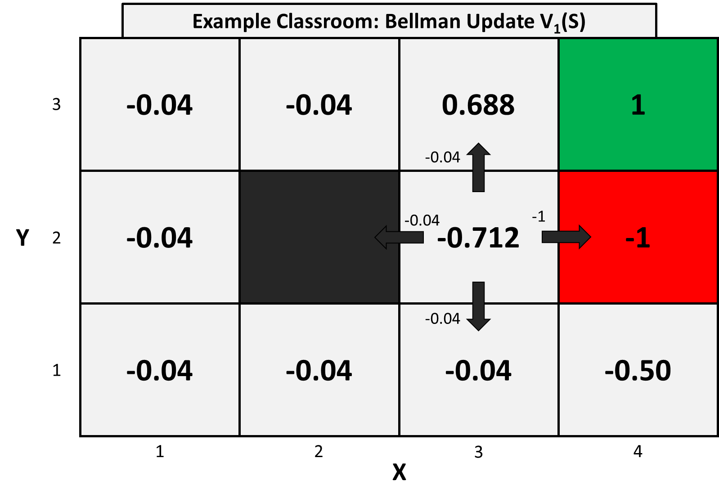
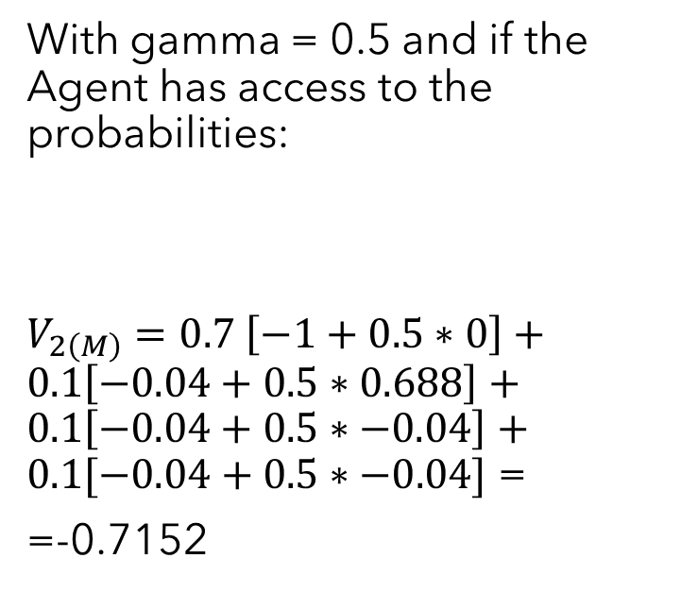
Model-Based Update
With gamma = 0.5 and if the Agent has access to the probabilities:
$V_{2\left(M\right)}=0.7 \left[−1+0.5∗0\right]+0.1\left[−0.04+0.5∗0.688\right]+0.1\left[−0.04+0.5∗−0.04\right]+0.1[−0.04+0.5∗−0.04]$ =
=-0.7152
$$V_{k+1}(s)= \sum_{a}{π\left(a | s\right)\sum_{s^{′}}{P\left(s^{′} | s,a\right)\left[r+γv_{k}\left(s^{′}\right)\right], for all s∈S}}$$
r = +1 for positive goal,
r = -1 for negative goal,
r = -0.04 otherwise
A Simple Example

Slide 48
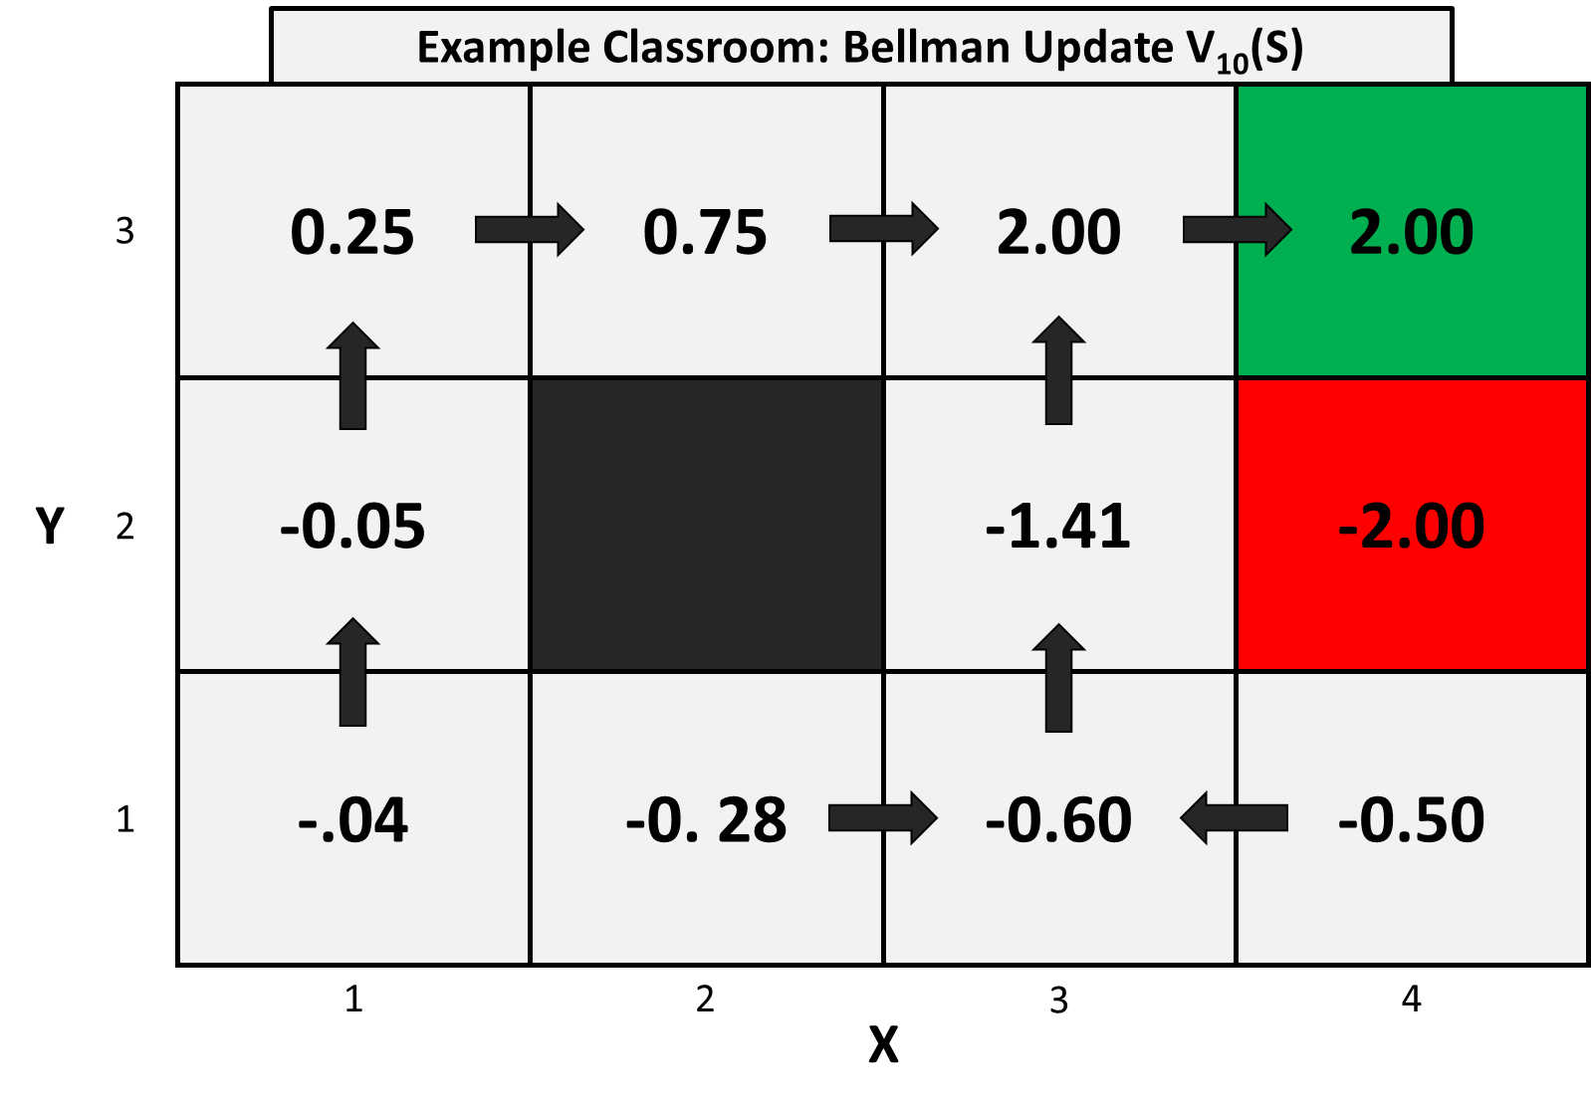
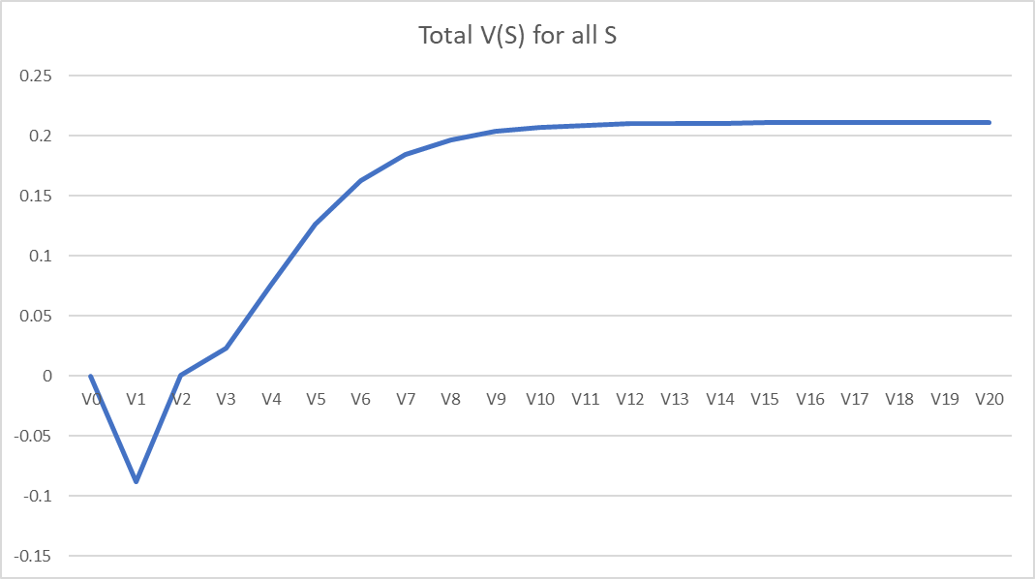
Model-Based Update
After many updates with current policy:
A Simple Example

Slide 49
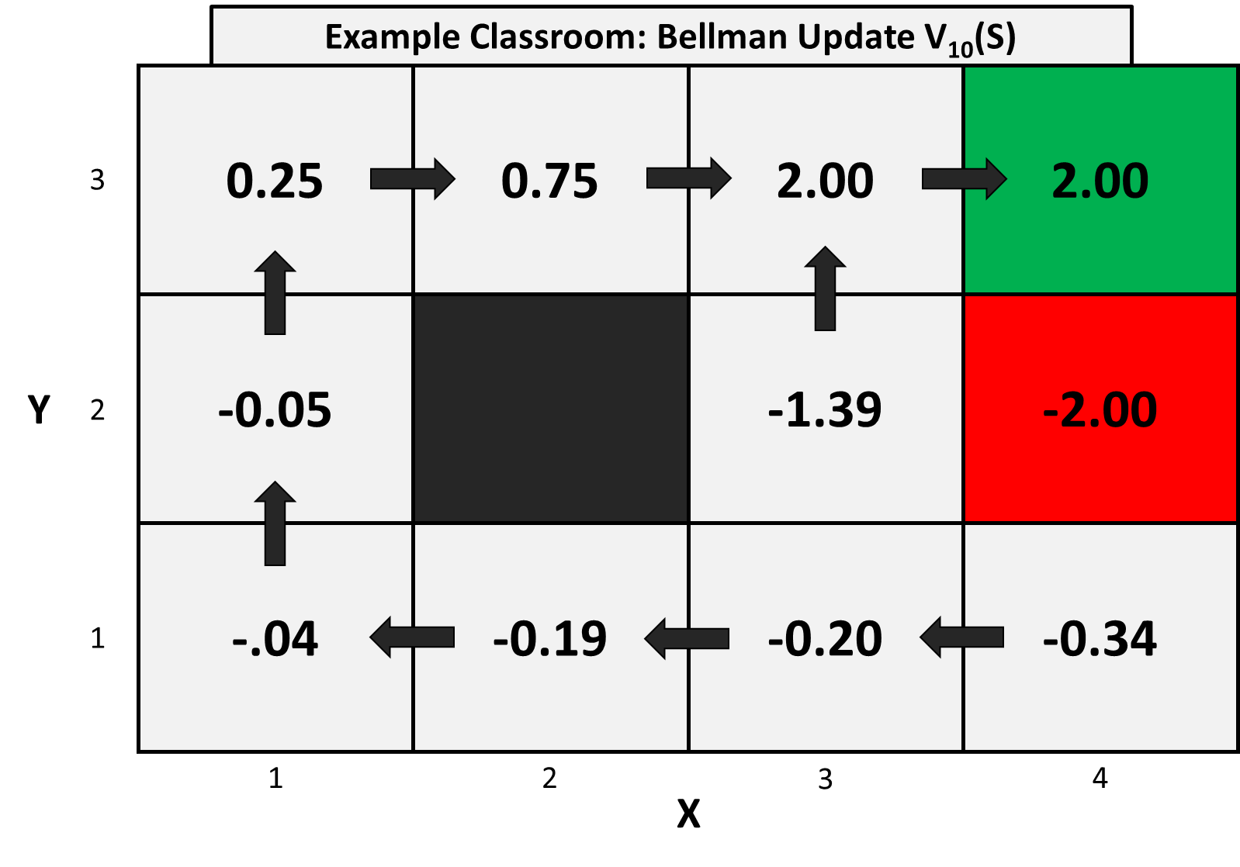
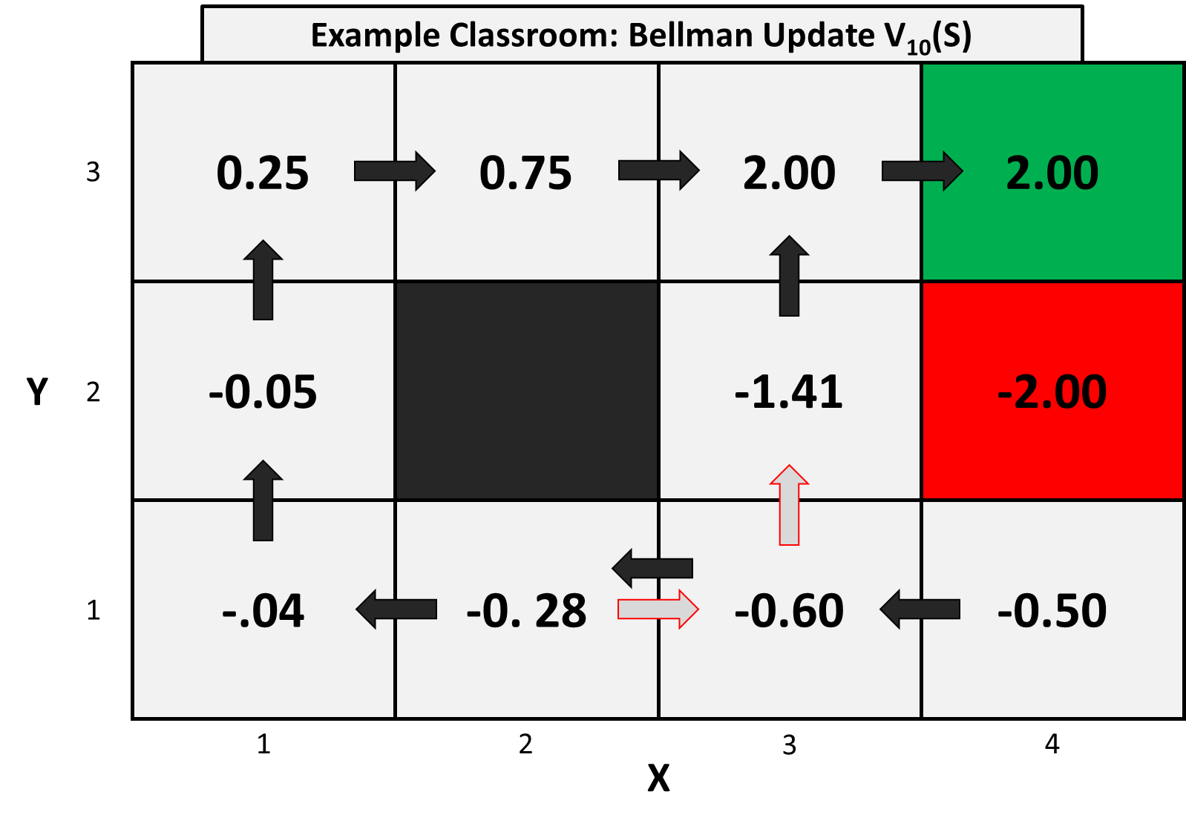
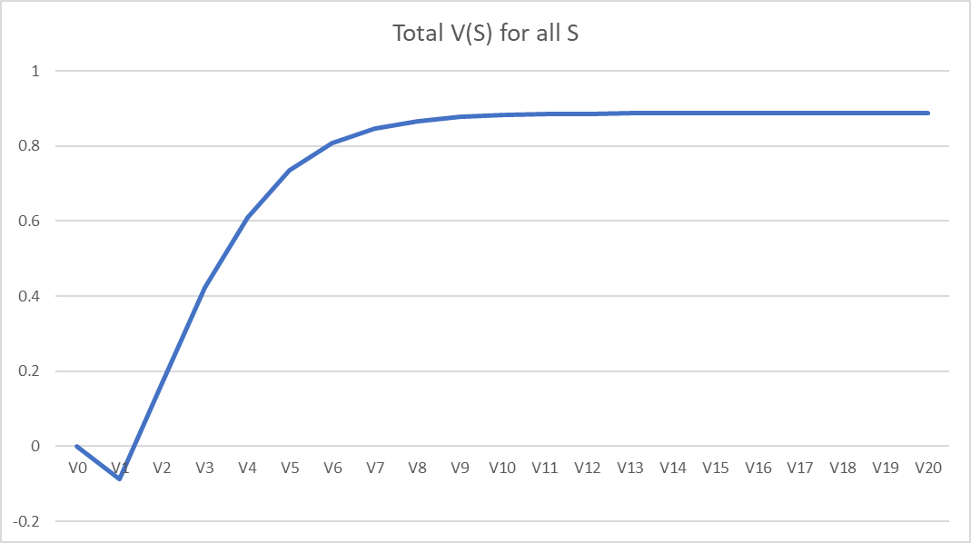
Model-Based Update
We then update the policy to:
A Simple Example

Slide 50
Model-Free Update
Example Classroom environment has been created in a Python Notebook
Go to Kaggle page to see Q-learning example: https://www.kaggle.com/osbornep/q-learning-for-the-classroom-environment
Try some challenges yourself:
1. Apply TD(0) update approach
2. Apply Monte Carlo update approach
3. Apply SARSA update approach
4. Compare learning patterns between each method
-------------------------------------------------------
1. Vary the Learning Rate $\alpha$
2. Vary the Discount Rate $\gamma$
3. Vary the Action Selection parameter $\epsilon$
-------------------------------------------------------
1. Change the probabilities of students following the command (e.g. Make "M" less likely to follow command)
2. Vary the Reward Signal to see how this effects learning, what happens if we don’t use r=-0.04 for all actions and instead use r=0
A Simple Example

